Slide 1
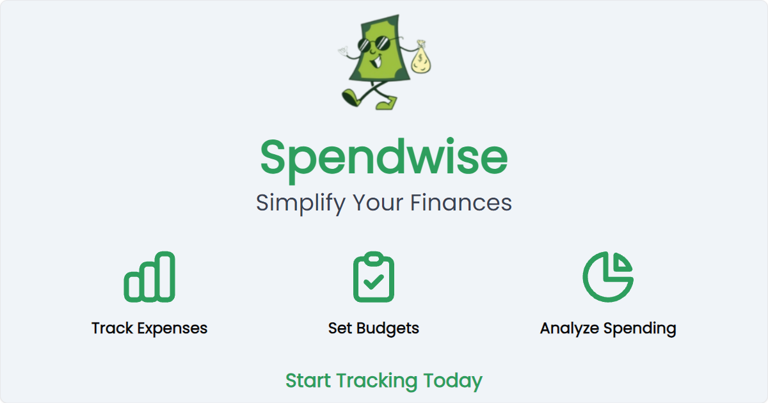
Spendwise – Smart Expense Management System

Slide 2
Introduction
SpendWise is a system used to track daily expenses.
It helps users understand where their money is spent.
The system records income, expenses, and savings.
It makes personal financial management easier.

Slide 3
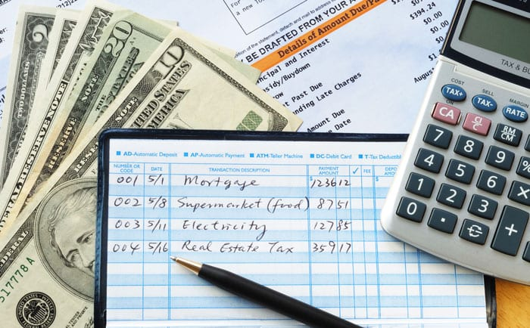
Objective
To help users manage their money effectively.
To record daily expenses easily.
To provide a clear view of spending habits.
To encourage better saving and budgeting.

Slide 4
Problem Statement
Many people do not track their daily expenses.
Money is often spent without proper planning.
Manual expense tracking can be confusing and time‑consuming.
A simple system is needed to manage expenses.

Slide 5

Proposed Solution
SpendWise provides a digital expense tracking system.
Users can record income and expenses in one place.
The system organizes spending information clearly.
It helps control unnecessary spending.

Slide 6
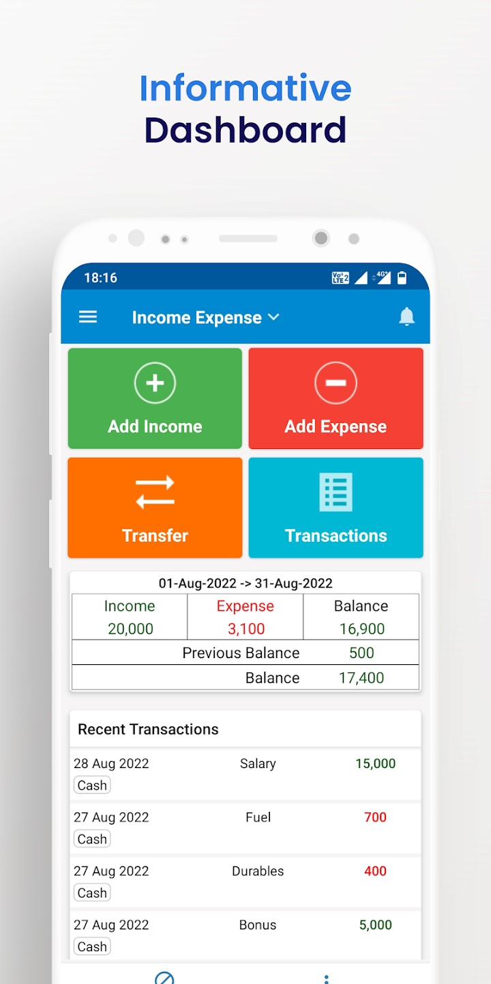
System Features
Add daily expenses
Record income
View expense history
Categorize expenses
Generate simple reports

Slide 7
Expense Categories
Food and groceries
Transportation
Bills and utilities
Entertainment
Shopping
Other personal expenses

Slide 8
Expense Recording
Enter the date of expense.
Enter the amount spent.
Select the category of expense.
Add a short description if needed.

Slide 9
Data Storage
All expense data is stored in a secure database.
Data can be accessed anytime by the user.
Records help track spending over time.

Slide 10
User Interface
Simple and easy-to-use design.
Clear menu options for adding expenses.
Easy navigation for viewing reports.
Suitable for beginners.

Slide 11
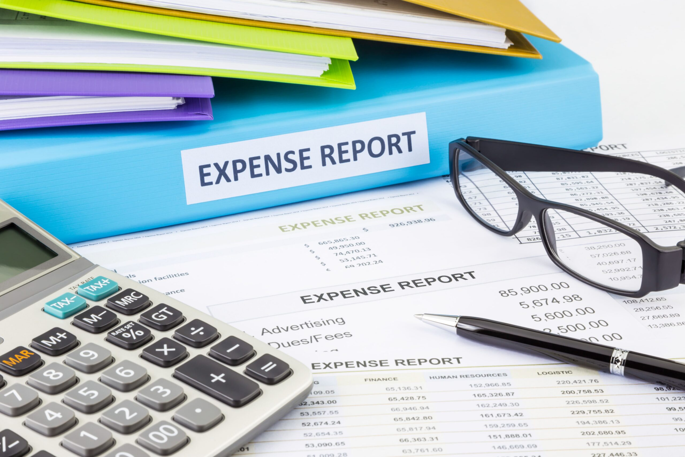
Expense Reports
Shows total spending over a period.
Displays spending in different categories.
Helps users analyze financial habits.

Slide 12
Advantages
Easy tracking of daily expenses
Helps control unnecessary spending
Improves financial awareness
Saves time and effort

Slide 13
Applications
Personal money management
Student expense tracking
Household budgeting
Small business expense monitoring

Slide 14
Future Improvements
Mobile app version
Automatic expense reminders
Graphical reports and charts
Integration with bank transactions

Slide 15
Conclusion
SpendWise is a simple and useful expense management system.
It helps users track and control their spending.
Encourages better financial planning and savings.

Slide 16
THANK YOU

